Slide 1
Causal Inference in NBA Datasets - POC

Slide 2
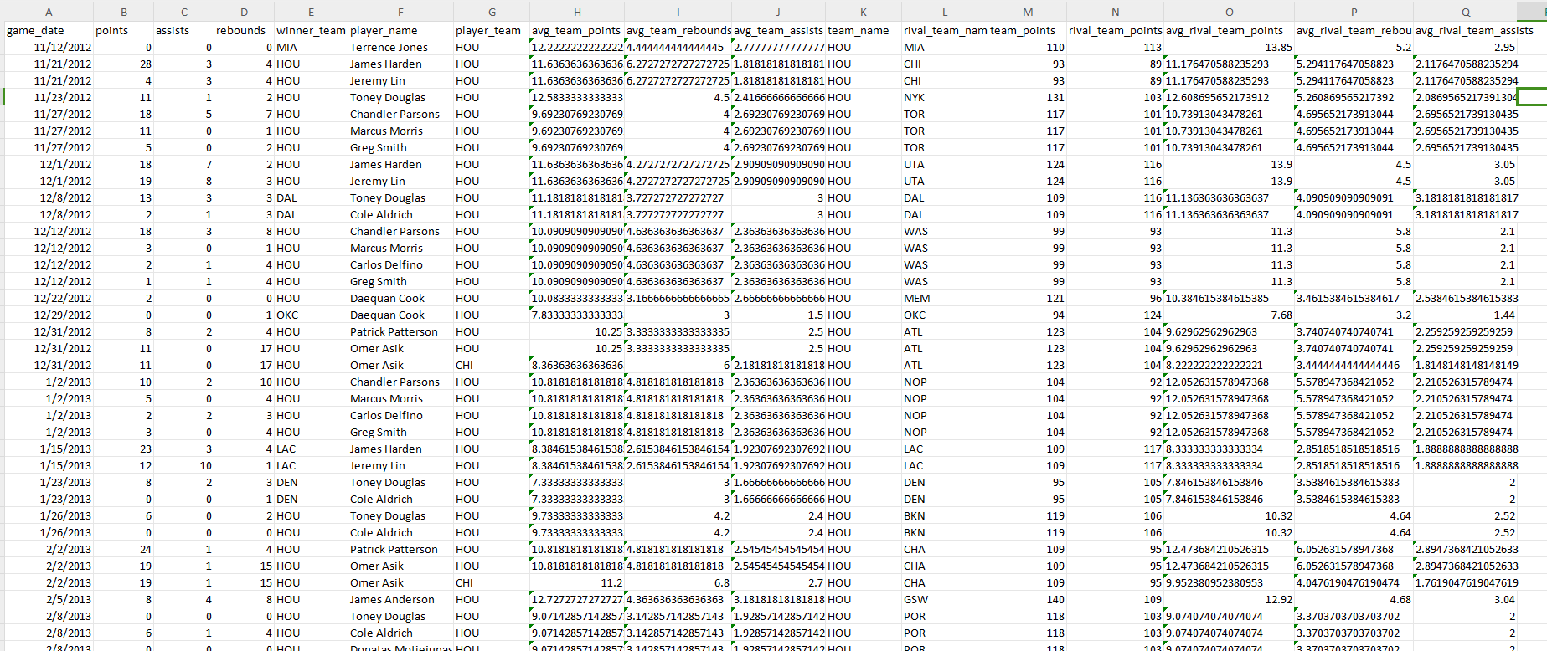
Datasets Preparation - Preprocess
Using 12 NBA datasets (game, lineup_stats, player_stats and more)
Join Player Stats, Player, Team and Game Datasets
Dataset Augmentations:
include player’s team (game_date in between start and end date)
Calculate Avg Points, Rbs, Ass, for team per game (using player team per game)
Calculate Avg stats for rival player team
Switch team and rival team instead of head and away team
Moving irrelevant columns

Slide 3
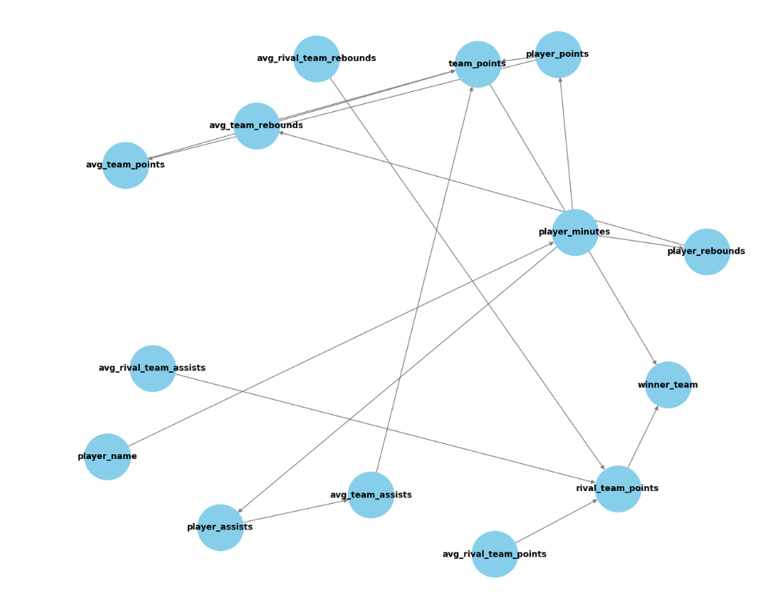
Dag Preparation - Preprocess
Team and Rival Team Points affect Winning team
Avg Team Stats (Points, Rebounds, Assists) Effect Team Points
Player Stats (Points, Rebounds, Assists) effect Avg Team Stats
Player’s Minutes Effect Personal Stats

Slide 4
Single Player-Focused Queries
Causal Unit - A Player In A Game
Treatment - Does A Player’s Stat happened in the game (0 / 1 values)
Mainly basic stats - available in the datasets (basic / advanced)
Can be one or more stats as long as it’s in the data / can be created from it
Outcome - Player’s team Winning the Game (0/1 values)
Method - Dataset and DAG Augmentation
Causal model (DoWhy package - identify and estimate effect)
Using backdoor.linear_regression, calculating ATE
Mean Value (values between [-1, 1]) , p-value need to be < 0.05 to be significant

Slide 5
Single Player-Focused Queries
Queries Pipeline
Find meaningful dues and relevant stats per player in the Dues
Filter for Player’s Team games and Player minutes > 0
Add binary columns - for winning outcome and for treatment question
Make Sure All Relevant column exist in preprocess DAG and dataset
Augment DAG to match new nodes and new Edges
Run Dowhy and check validity of the Query

Slide 6
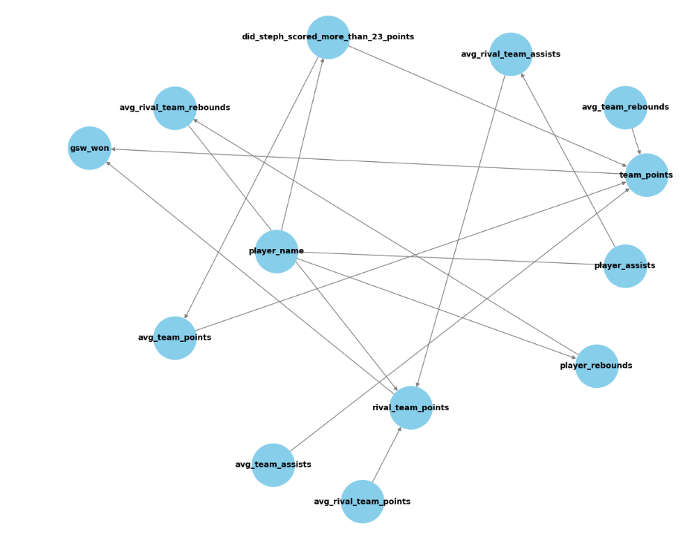
Query 1 - Steph Scored 23+ Points
1388 games with Steph Curry
742 Games with 23 + Points (646 Less)
Mean value: 0.1251293329528778
p-value: [1.95557452e-07]

Slide 7
About Usage Stats
Benchmarks for Usage Rate:
Below 15%: Low usage (usually role players or defensive specialists).
15-20%: Average usage (typical for complementary players).
20-25%: Above average (key contributors or second options).
25-30%: High usage (primary scorers and offensive leaders).
Above 30%: Very high usage (stars or superstars dominating the offense).
Above 35%: Exceptional usage (reserved for players like prime James Harden, Kobe Bryant, or Luka Dončić).

Slide 8
Query 2 - Kobe's usage
Case 1 - 33% Usage or more
382 yes 414 no
Mean value: 0.01752788527202398
p-value: [0.62110584]
No statistical significant difference between "yes" and "no" (high p-value)
Observed mean difference is likely due to chance.
Case 2 - 40% Usage or more
110 yes 686 no
Mean value: -0.17211767824012636
p-value: [0.000767]
Statistically significant result (very low p-value)
Kobe’s increased usage significantly correlates with a negative effect on winning
Too Much Usage Affect Negatively on Winning

Slide 9
Chris Paul
Known as the "Point God," was one of the NBA's top point guards in the 2010s
Played for the New Orleans Hornets, Los Angeles Clippers, and Houston Rockets.
Famous for his elite playmaking, consistently ranking among league leaders in assists
His leadership and vision transformed teams, helping them win many games

Slide 10
Query 3 + 4
Query 3 - Kobe 30+ Points
246 yes 550 no
Mean value: 0.0741561824876058
p-value: [0.03206079]
Query 4 - Chris Paul 13+ assists
874 yes 426 no
Mean value: 0.15339062603933706
p-value: [1.98663328e-06]

Slide 11
Query 5 +6 - Russell Westbrook and Kevin Durant
Dominated the NBA in the most of the 2010’s
both great scorers - KD one of the best in history
Westbrook also great rebounder and assister
Consistently been in the playoffs and won a lot of games together
Query 5 - Westbrook 20+ Points
946 yes 522 no
Mean value: -0.017383202174984902
p-value: [0.50330585]
Query 6 - Durant 25+ Points
982 yes 408 no
Mean value: 0.09188719768189268
p-value: [0.00112816]
Not statistically significant result, mean value close to 0
Both players played in great teams - if the player is not at his best, the team will cover for him and still win

Slide 12
Due Player-Focused Queries
Causal Unit - Two Players In A Game
Treatment - Does Two Player’s Stats happened in the game (0 / 1 values)
Mainly basic stats - available in the datasets (basic / advanced)
Can be one or more stats as long as it’s in the data / can be created from it
Outcome - Team Winning the Game (0/1 values)
Method - Dataset and DAG Augmentation
Causal model (DoWhy package - identify and estimate effect)
Using backdoor.linear_regression, calculating ATE
Mean Value (values between [-1, 1]) , p-value need to be < 0.05 to be significant

Slide 13
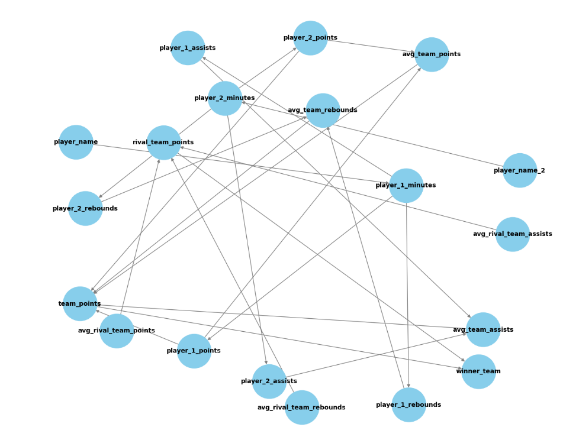
Due Player-Focused Queries
Find meaningful dues and relevant stats per player in the Dues
played many games together (same team same time)
had successful careers together
Filter the Players and games both played
Split player to different datasets, extracting relevant stats then merging datasets
DAG similar to Solo DAG - Now including both player names and stats
DAG Augmentation - Now for both players (AND Query)
Run Dowhy and check validity of the Query

Slide 14
Query 1 - Steph and Kley
Also Known as the “Splash Brothers”
Dominated the NBA in the second half of the 2010s
both great scorers
won 3 championships in 2015, 2017, 2018
Curry Scoring 23+ points and Kley Scoring 20+ points - both in same game
value counts
0 380
1 145
creating binary winning column - for gsw
replacing new node with both player’s points and effecting team points
Mean value: 0.1405836521251056
p-value: [0.0007939]
Statistically significant result, mean value is positive but not very high
Both players are great individually - if one is good it’s enough for winning the game

Slide 15
Curry And Klay - Different Points
Curry Scoring 23+ points and Kley Scoring 20+ points - original query
Mean value: 0.1405836521251056
p-value: [0.0007939]
Curry Scoring 20+ points and Kley Scoring 15+ points
Mean value: 0.20741956488698388
p-value: [7.31473473e-08]
Curry Scoring 15+ points and Kley Scoring 20+ points
Mean value: 0.18786581852379403
p-value: [1.24731824e-06]
Curry Scoring 15+ points and Kley Scoring 15+ points
Mean value: 0.2499127689702093
p-value: [8.89729665e-10]
Curry Scoring 20+ points and Kley Scoring 10+ points
Mean value: 0.07668168933111508
p-value: [0.04373312]
When Curry and Klay are both has solid scoring games - team is winning the most

Slide 16
Query 2 - Russell Westbrook and Kevin Durant
Durant Scoring 25+ points, Westbrook Scoring 20+ points - both in same game
value counts
0 341
1 215
Mean value: -0.025751892518584008
p-value: [0.52824667]
One can be good and they would still win
Durant Scoring 25+ points, Westbrook Assisting 10+ assists - both in same game
value counts
0 101
1 455
Mean value: 0.10080049176669204
p-value: [0.02399253]
Both complement each other for winning

Slide 17
Team-Focused Queries
Causal Unit - A Team In A Game
Treatment - Does A Team Collective Stat happened in the game (0 / 1 values)
Mainly basic stats - available in the datasets (basic / advanced)
Can also include team Rating (Off, Def), Player Stats in team
Outcome - Team Winning the Game (0/1 values)
Method - Dataset and DAG Augmentation
Causal model (DoWhy package - identify and estimate effect)
Using backdoor.linear_regression, calculating ATE
Mean Value (values between [-1, 1]) , p-value need to be < 0.05 to be significant

Slide 18
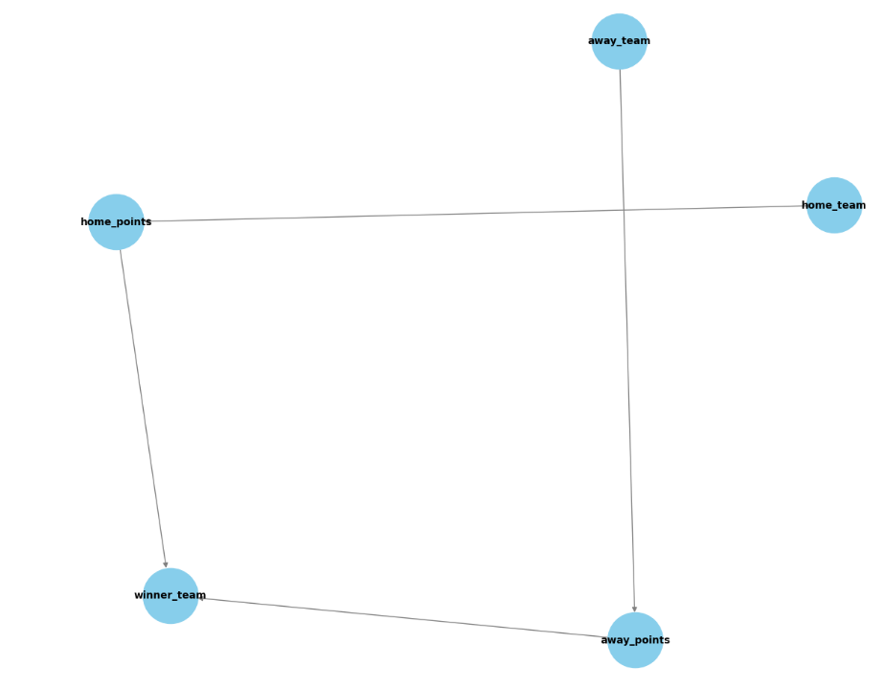
New Query - Home Team Winning
Only including game and Team Datasets (no Player Stats)
Including Team Names instead of IDs
Outcome - Do Teams Win more at home?

Slide 19
Does Home-Court Advantage Help Winning?
Home teams are believed to have a higher probability of winning
Factors like Familiar Surroundings, Reduced Travel Fatigue and Supportive Fans (loud and engaged) can help winning team
On the other hand - Lack of Fan Engagement, Shared Identity with Another Team and Uninspiring Facilities can lessen the positive effect of home court

Slide 20
Does Home-Court Advantage Help Winning?
Generally Checking if team playing home game effect positively of winning - around 0.20 mean value with very low p-value (checked 7 teams)
But there is a difference in performances across teams:
Denver Nuggets
The Mile-High City's altitude challenges visiting teams, combined with an energized fan base at Ball Arena
Historically one of the tougher places to win for visiting teams.
Mean value: 0.26119402985074636
p-value: [4.1771605e-14]
Los Angeles Clippers
Consistent losing seasons and front-office instability an easy venue for visiting teams.
Mean value: 0.1467661691542289
p-value: [1.28851548e-05]

Slide 21
Rival Players-Focused Queries
Causal Unit - Two Players Playing Against each other in a game
Treatment - Player A Stats against Rival Player B Stat happened in the game (0 / 1 values)
How Player A playing against player B effect it’s winning
Outcome - Player A’s Team Winning the Game (0/1 values)
Method - Dataset and DAG Augmentation
Causal model (DoWhy package - identify and estimate effect)
Using backdoor.linear_regression, calculating ATE
Mean Value (values between [-1, 1]) , p-value need to be < 0.05 to be significant

Slide 22
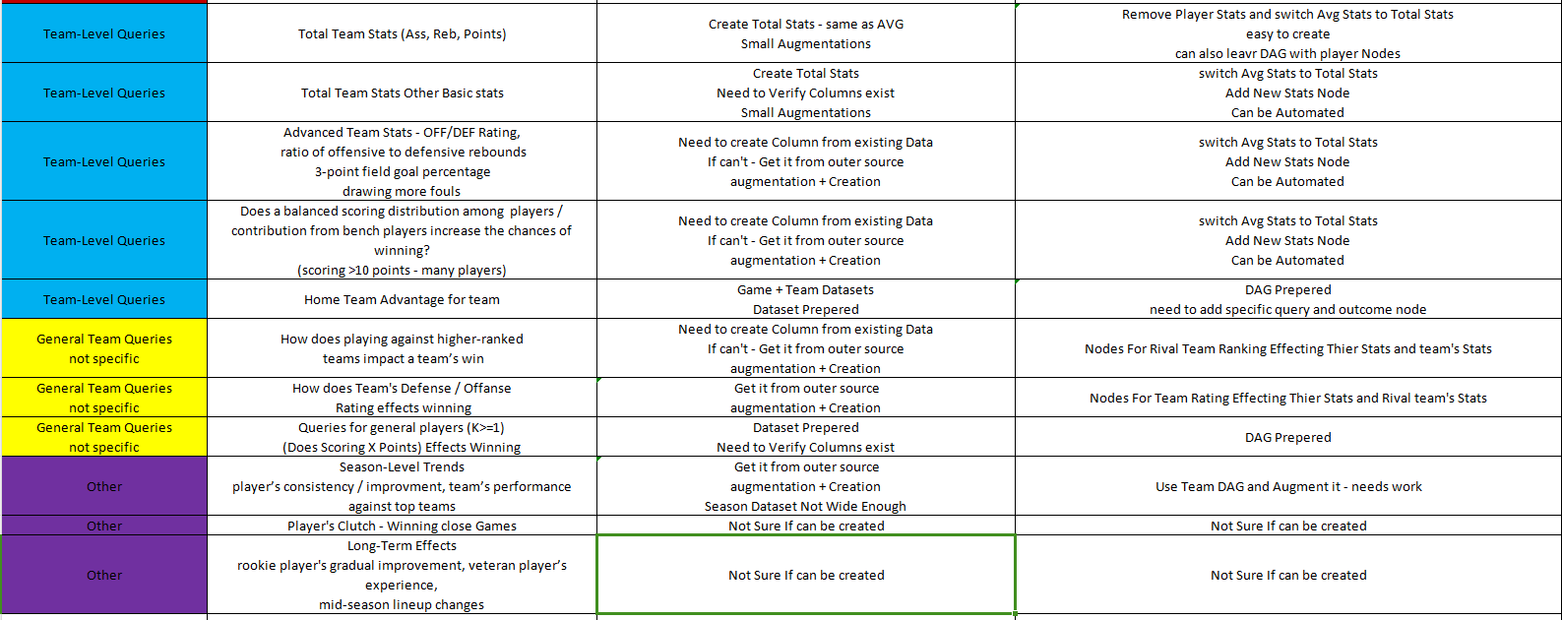
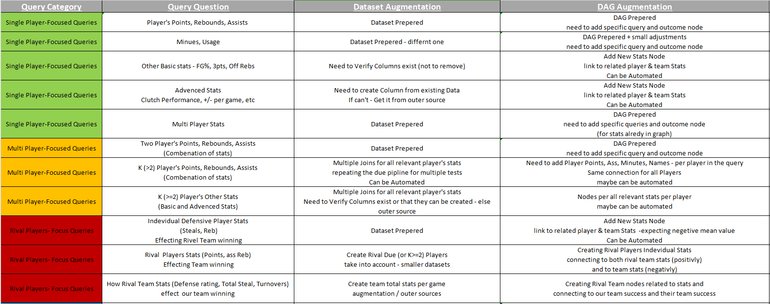
Current Status - Abilities Set

Slide 23
Main Takes from the POC
Every Query can be tested using the causal inference method as long as:
It’s based on existing data that appears in NBA datasets (Sports Reperences)
It’s easy to extract the needed data from the query (Aka , treatment, outcome, causal unit and subject)
We it’s can fit into one of the previously presented Query types
Each Causal unit (Player in a game, team in a game, Etc.) derives new causal DAG, new dataset to work on and different process for query assessment
This process can be fully automated, depands on the datasets and the “richness” of the queries.

